Slide 1
Cuisine of Warsaw
Capstone Project - The Battle of Neighborhoods

Slide 2
Business problem
The aim of this project is to analyse restaurants in Warsaw, Poland and check which cuisines are most popular in the city’s districts. This information may be beneficial to people planning to open a new restaurant to better understand the market, competition and customers in different parts of Warsaw.

Slide 3
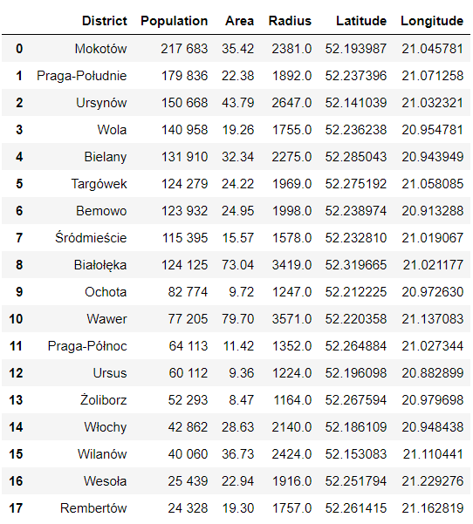


Data & Sources

Slide 4




Methodology
Python libraries: numpy, pandas, geopy, folium, sklearn, matplotlib
Machine Learning algorithm: K-Means

Slide 5
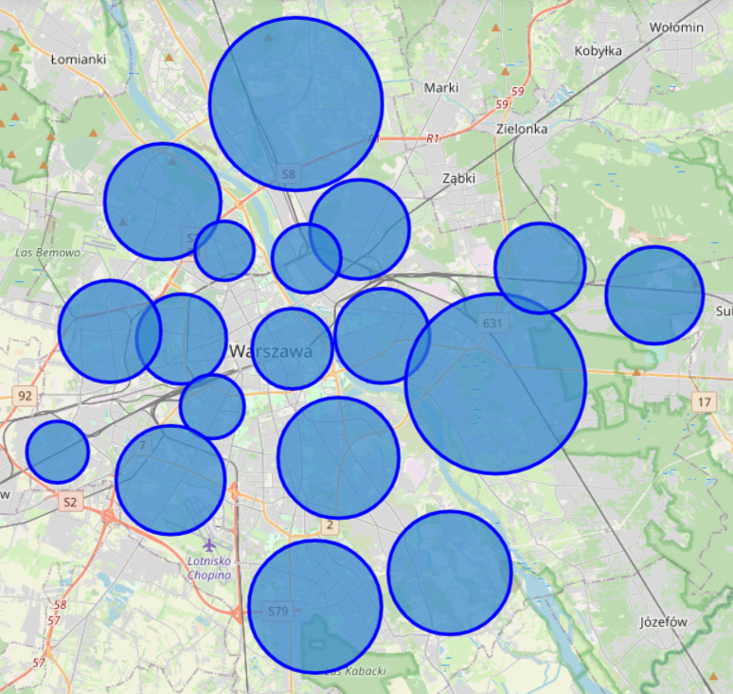
Folium Map of districts

Slide 6
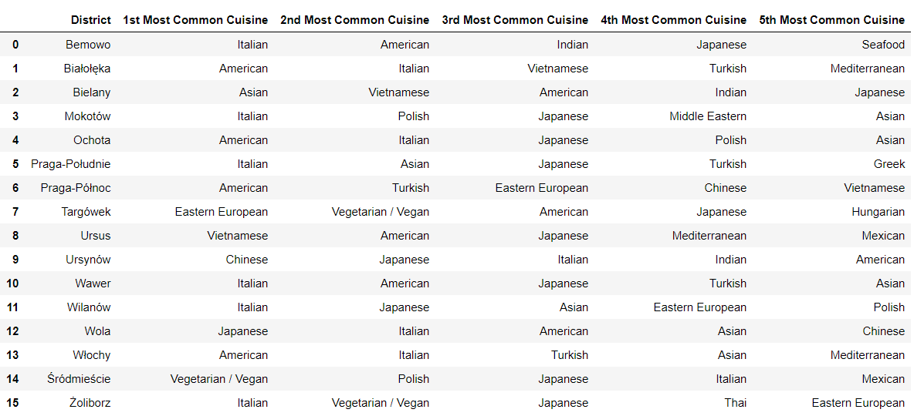
Top cuisines by district

Slide 7
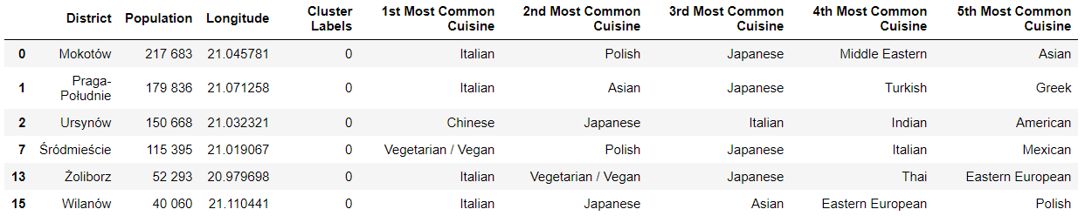
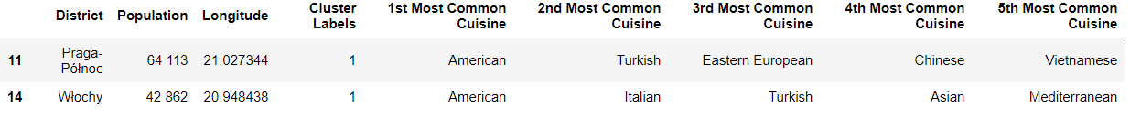
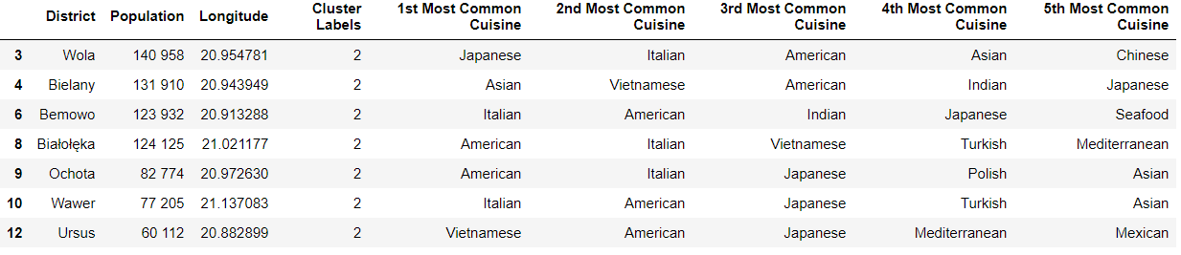
Clusters – Grouped districts
1
2
3
4

Slide 8
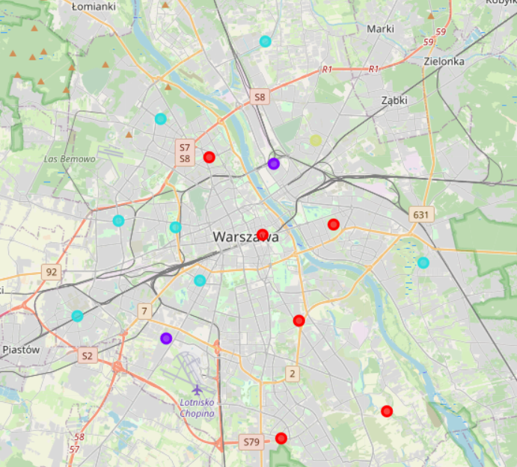
Clusters visualization

